Slide 1

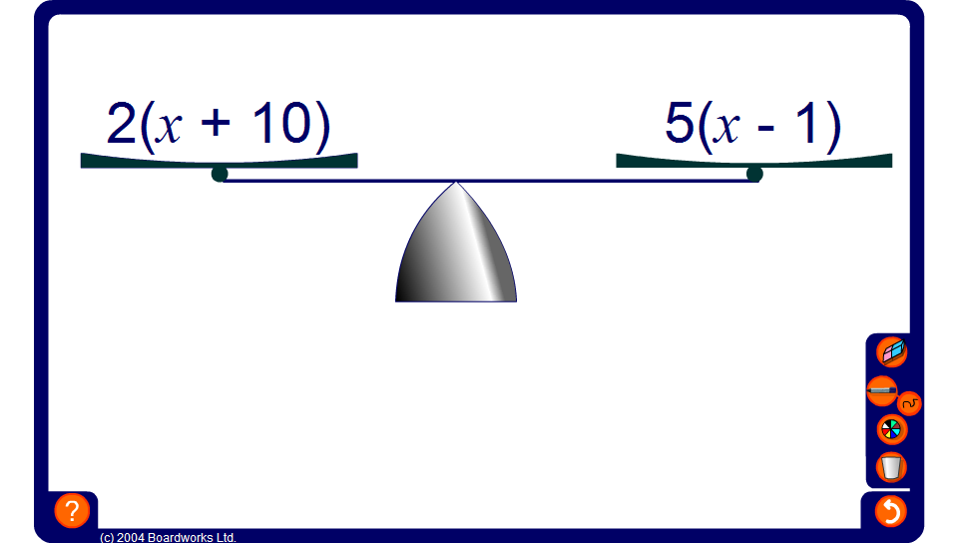


Balancing equations with brackets
Notes:
Go through some more examples using the pen tool to record each stage.
Ask pupils to tell you each transformation to be performed on both sides of the equation and to justify their choice in each case.

